Slide 1
Fingerprint Composition
Sarychev Nikita, Khramov Andrey, 6113.

Slide 2
Contents
Introduction
Purpose
Materials and Methods
Statistical Processing
Kinetic Analysis
Validation of the method
Discussion
Experiments
Results

Slide 3
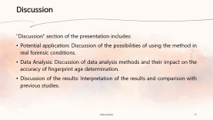
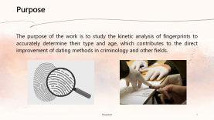
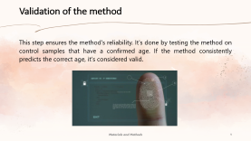
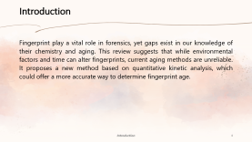
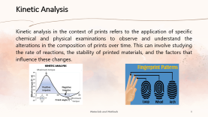
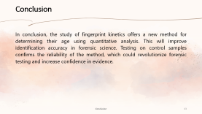
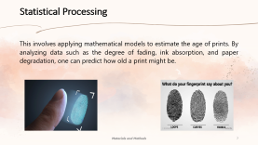
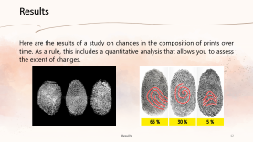
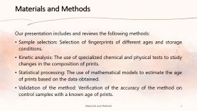
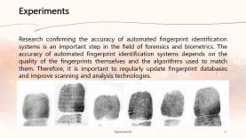
Interactive Menu

Slide 4
Introduction
Fingerprint play a vital role in forensics, yet gaps exist in our knowledge of their chemistry and aging. This review suggests that while environmental factors and time can alter fingerprints, current aging methods are unreliable. It proposes a new method based on quantitative kinetic analysis, which could offer a more accurate way to determine fingerprint age.

Slide 5
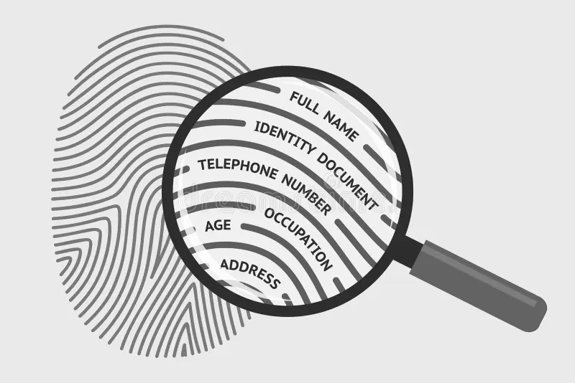
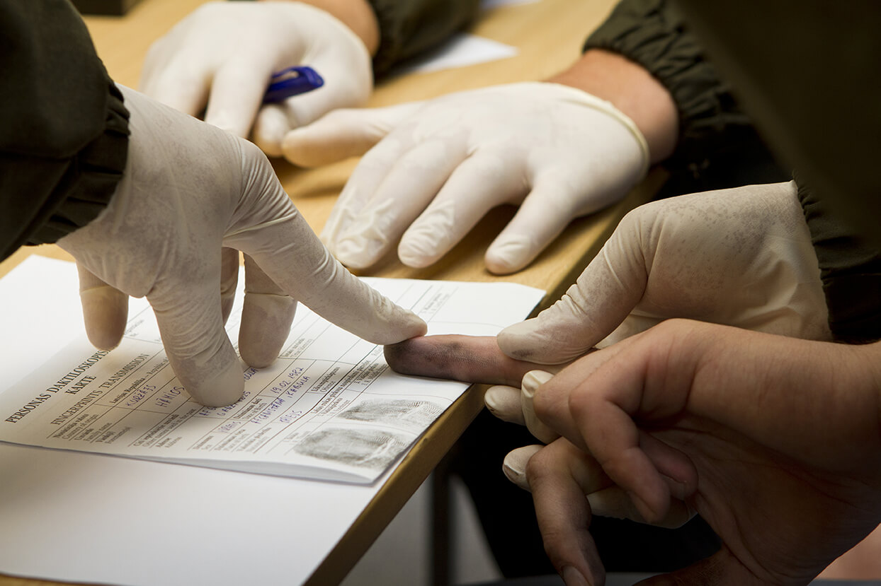
Purpose
The purpose of the work is to study the kinetic analysis of fingerprints to accurately determine their type and age, which contributes to the direct improvement of dating methods in criminology and other fields.

Slide 6
Materials and Methods
Our presentation includes and reviews the following methods:
Sample selection: Selection of fingerprints of different ages and storage conditions.
Kinetic analysis: The use of specialized chemical and physical tests to study changes in the composition of prints.
Statistical processing: The use of mathematical models to estimate the age of prints based on the data obtained.
Validation of the method: Verification of the accuracy of the method on control samples with a known age of prints.

Slide 7
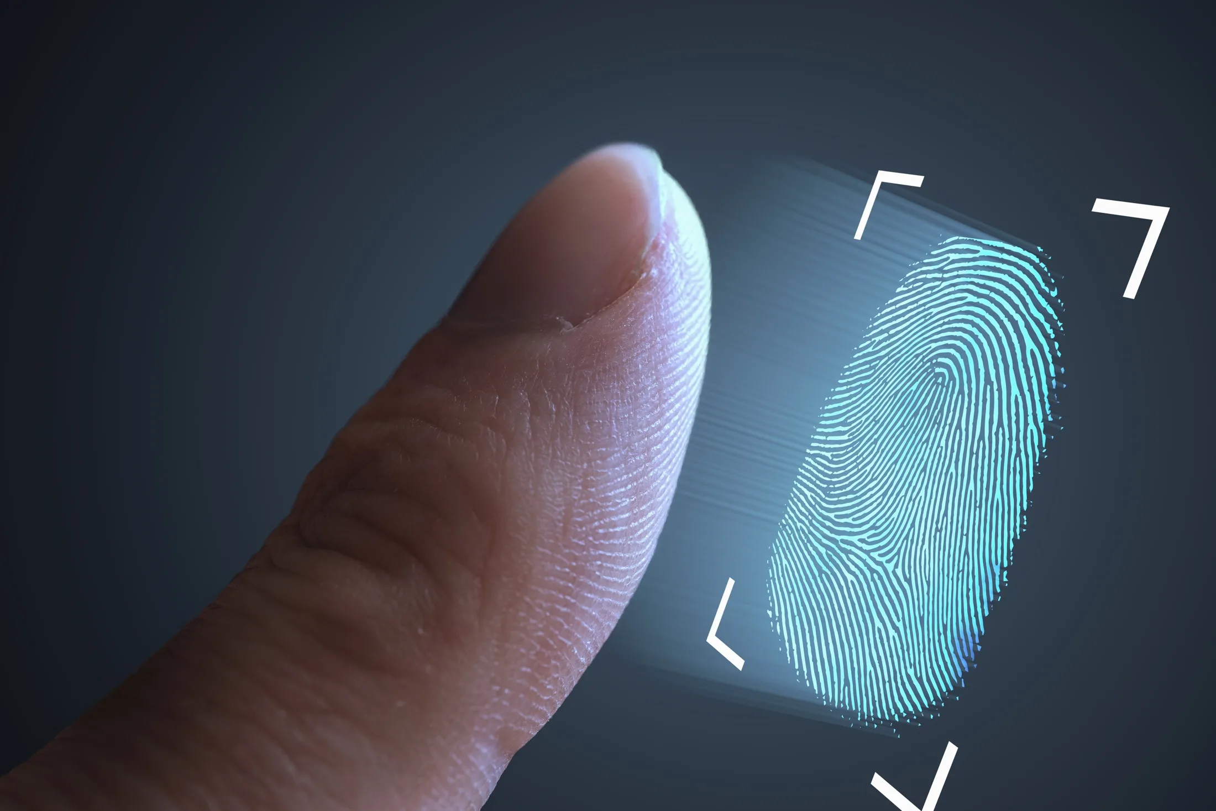
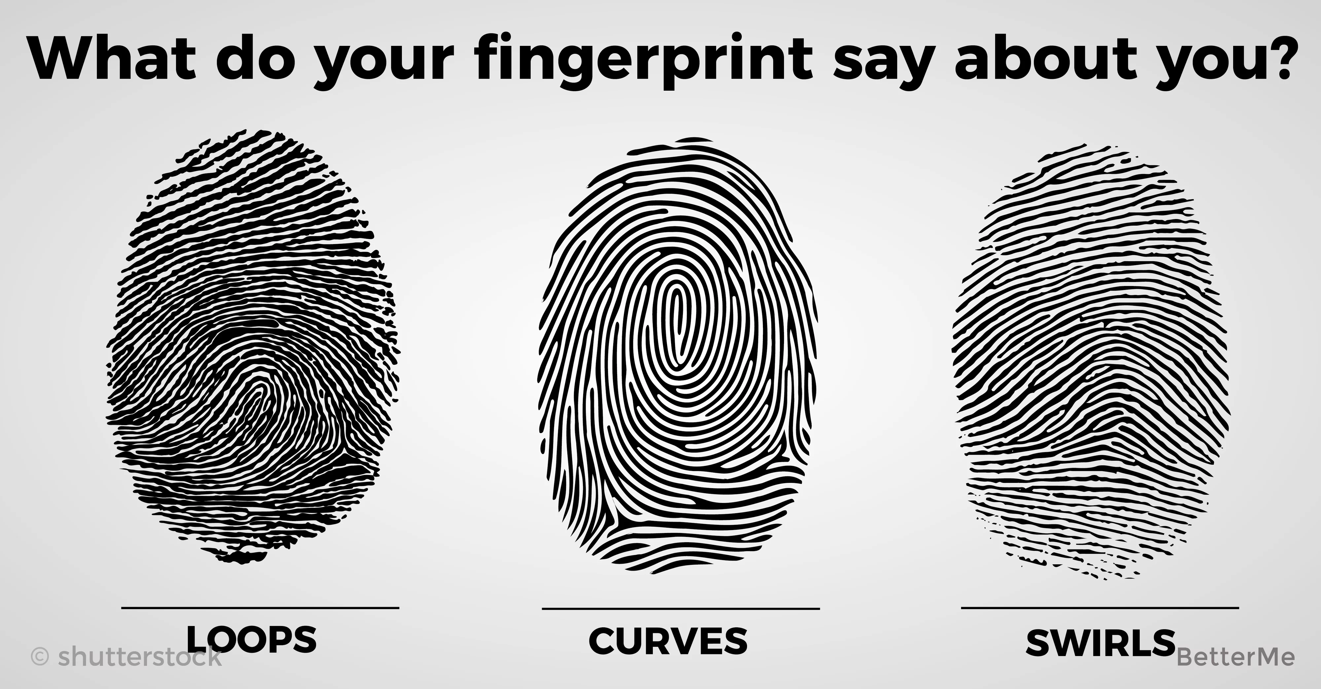
Statistical Processing
This involves applying mathematical models to estimate the age of prints. By analyzing data such as the degree of fading, ink absorption, and paper degradation, one can predict how old a print might be.

Slide 8
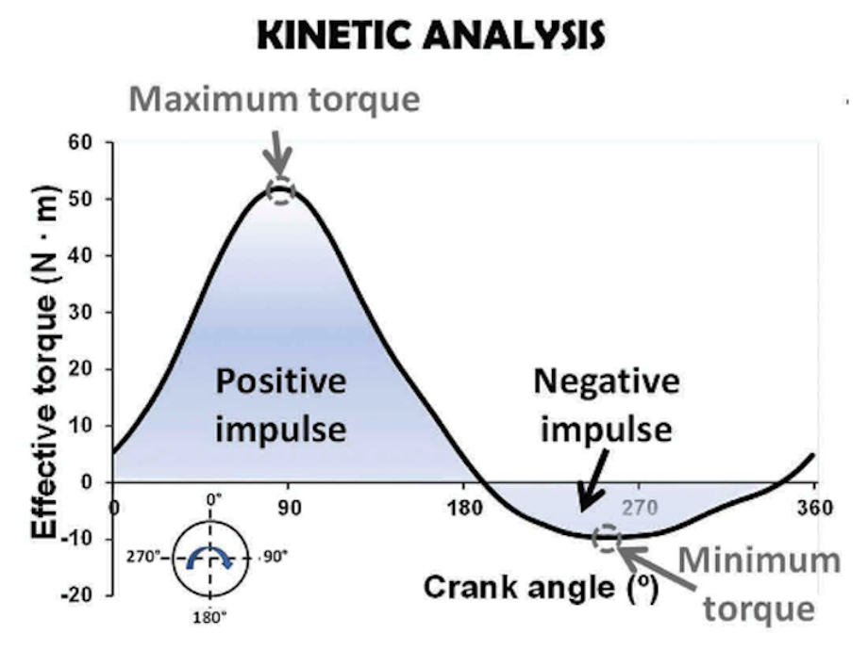
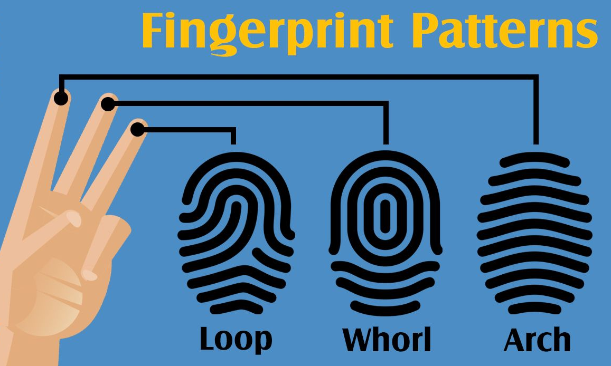
Kinetic Analysis
Kinetic analysis in the context of prints refers to the application of specific chemical and physical examinations to observe and understand the alterations in the composition of prints over time. This can involve studying the rate of reactions, the stability of printed materials, and the factors that influence these changes.

Slide 9
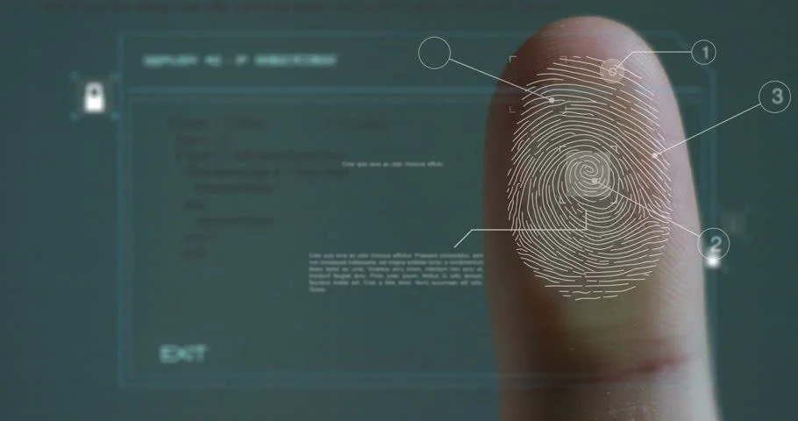
Validation of the method
This step ensures the method's reliability. It's done by testing the method on control samples that have a confirmed age. If the method consistently predicts the correct age, it's considered valid.

Slide 10
Discussion
"Discussion" section of the presentation includes:
Potential application: Discussion of the possibilities of using the method in real forensic conditions.
Data Analysis: Discussion of data analysis methods and their impact on the accuracy of fingerprint age determination.
Discussion of the results: Interpretation of the results and comparison with previous studies.

Slide 11
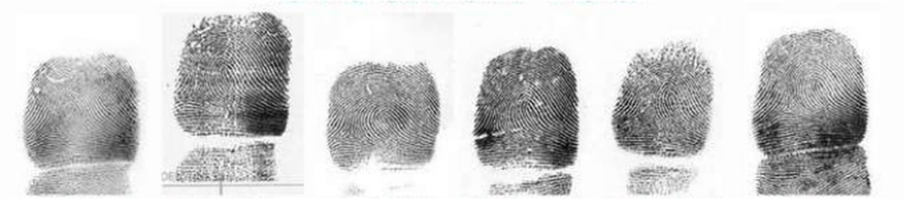
Experiments
Research confirming the accuracy of automated fingerprint identification systems is an important step in the field of forensics and biometrics. The accuracy of automated fingerprint identification systems depends on the quality of the fingerprints themselves and the algorithms used to match them. Therefore, it is important to regularly update fingerprint databases and improve scanning and analysis technologies.

Slide 12
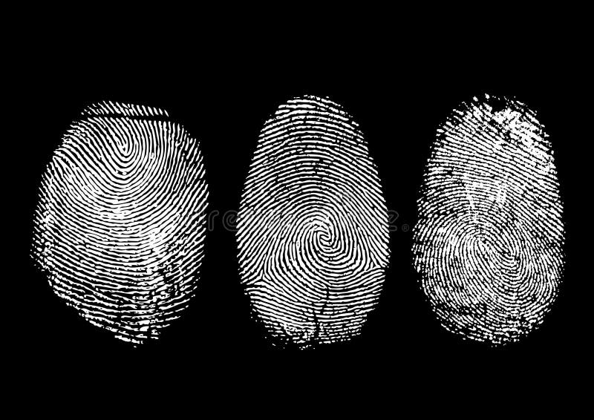
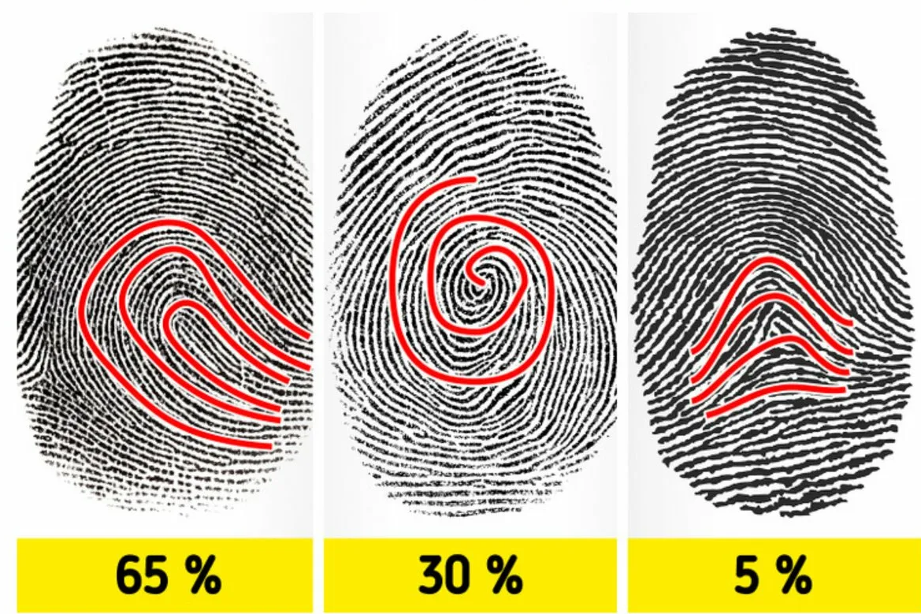
Results
Here are the results of a study on changes in the composition of prints over time. As a rule, this includes a quantitative analysis that allows you to assess the extent of changes.

Slide 13
Conclusion
In conclusion, the study of fingerprint kinetics offers a new method for determining their age using quantitative analysis. This will improve identification accuracy in forensic science. Testing on control samples confirms the reliability of the method, which could revolutionize forensic testing and increase confidence in evidence.

Slide 14
Thank you for your attention!

